Slide 1
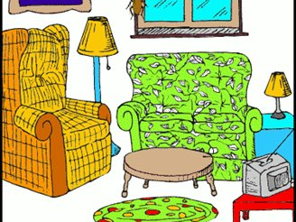
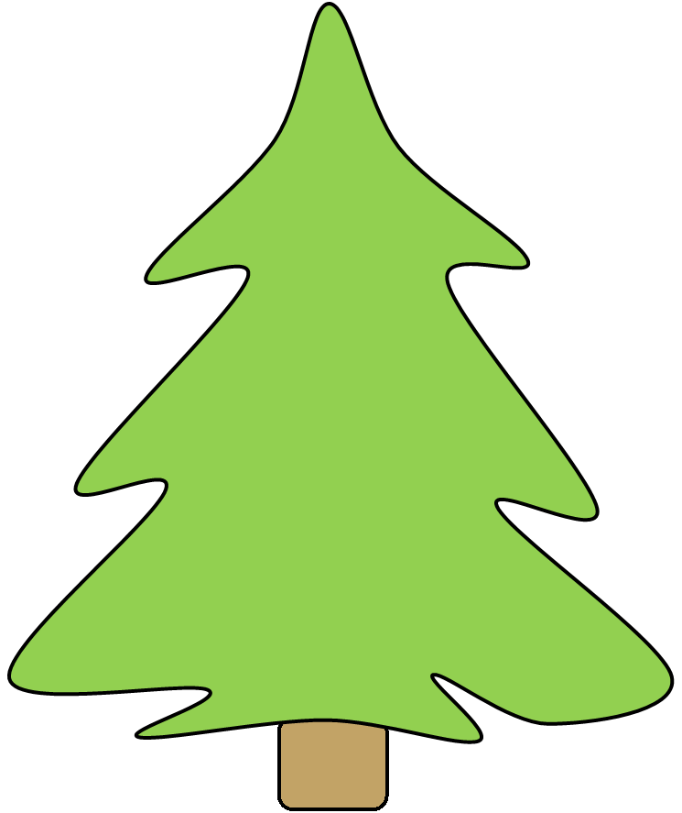
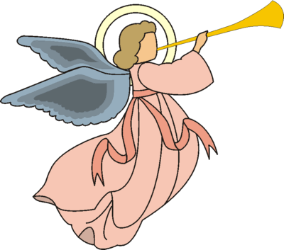
Notes:
Welcome to your Advent Symbolism Quiz!
To Use: Click on the ‘Slide Show’ tab at the top of the screen and select ‘From Beginning’.
From this first Christmas scene slide you can click on any of the decorations on the Christmas tree, including the presents underneath and the tree itself. This will take you to a question about that decoration. Once you have decided on your answer, click once to reveal the real answer and see if you were right. You will also see a blue box with additional information.
When you have finished reading, simply click on the Christmas tree symbol at the bottom right-hand corner of the page to return to the original Christmas scene and select another decoration.
Alternatively, you can view the slides in order to just see the questions and answers. Have fun!

Slide 2
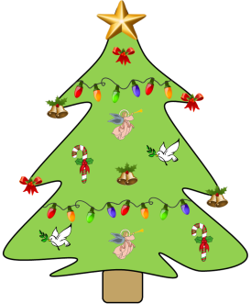
Mission Together
What does the angel represent?
That this is a time to sing Christmas Carols
The angels who told the shepherds
about Jesus
(c) That Christmas is magical
The angels we use as decorations at Christmas are meant to represent the angels that came to the shepherds who were looking after their sheep on the night that Jesus was born.
The angels told the shepherds not to be afraid and explained that they brought Good News. They said the shepherds would find a baby in a manger and that this was Christ the Saviour.

Slide 3
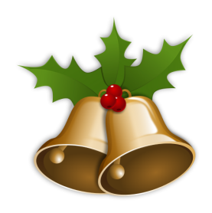
Mission Together
Why do we use bells as decorations?
Because bells are rung to announce good news
Because they remind us to go to church
(c) Because they sound pretty
Bells are usually rung to announce good news like a wedding or a call to Mass. At Christmas we hear the good news that Jesus has come into the world.
Bells symbolise the true meaning of Christmas, which is Jesus’ birth, and they remind us of how important this is.

Slide 4
Mission Together
Why do we give presents?
Because we want to get presents in return
Because it is a kind thing to do
(c) Because the three wise men brought
gifts for the baby Jesus
Traditionally we give presents at Christmas because we are celebrating the birth of Jesus. We give gifts as a symbol of the gold, frankincense and myrrh that the three wise men brought for Jesus when he was born.
Presents are also a reminder of the precious gift that we were all given by God. He gave us his son Jesus because he loves us so much.

Slide 5
Mission Together
What do sugar canes stand for?
They are meant to look like Jesus on a cross
Nothing, they are just there to taste good
(c) They symbolise the shepherd’s crook
Shepherds appear a lot in the Bible. At Christmas we remember the story of the angels visiting the shepherds to give them the good news of Jesus’ birth.
Another important thing to remember is that Jesus is our shepherd. He guards us and guides us like a shepherd does with his sheep. He keeps us safe and he loves us, and this is what the sugar canes help us to remember at Christmas.

Slide 6
Mission Together
What does the dove represent?
Jesus
The Holy Spirit
(c) Nature
The dove is often seen as a symbol of the Holy Spirit. At Jesus’ baptism in the River Jordan, the Holy Spirit comes down to Jesus like a dove, showing Jesus’ purity and holiness.
It is through the Holy Spirit that Mary becomes pregnant with Jesus, which is why the dove makes a perfect Christmas symbol.
Of course the dove also represents peace, which is something special to remember and pray for during Christmas.

Slide 7
Mission Together
What does the bow mean at Christmas?
It stands for Jesus being a gift from God
It stands for the presents we buy
(c) It makes things look nice
The bow is meant to remind us of the precious gift we receive from God: the gift of Jesus.
God gave us his son because he loves us so much and wants us to have eternal life in heaven. He knew that Jesus would have to suffer and die for us, but he made this sacrifice for us.
When we see a bow, we remember God’s love for us.

Slide 8
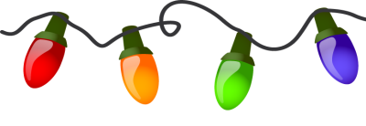
Mission Together
What do Christmas lights represent?
Snowflakes falling from the sky
Jesus as the Light of the World
(c) The brightness and joy of Christmas
Traditionally, people would put candles on their Christmas trees as a symbol of the light of Jesus. Now we use electric lights but they still represent Jesus as the Light of the World.
Some also see the lights as symbols of the stars in the sky on the night that Jesus was born. The lights are also a reminder to us to bring the light of Christ to others.

Slide 9
Mission Together
Why is there a star at the top of the tree?
It stands for the Star of Bethlehem
It is the closest place to the sky
(c) It means that Jesus is a star
The star at the top of the Christmas tree is used to represent the Star of Bethlehem, which shone above Jesus when he was born and guided the three wise men to the stable.
It reminds us of the importance of Jesus’ birth and helps to guide us to him at Christmas, just as it guided the three wise men to him when he was born.

Slide 10
Mission Together
What is the meaning of the Christmas tree?
It helps to bring nature inside when it is
too cold to go out
(b) It points up to heaven so we remember God
(c) It is evergreen, which shows God’s
everlasting love for us
Evergreen trees have been a part of Christmas for a very long time (since about 1510!). These trees stay green all year round, even during winter when other trees lose their leaves. For this reason, they represent the everlasting hope that Jesus brings us and the everlasting love of God.
Some even say that the needles of a Christmas tree point towards heaven.

